Slide 1
Kinetic FIO Engine Design

Slide 3
FIO Background
FIO
flexible test case definition
control over block size, length, duration, rand/seq io patterns, sync/async control, multi threaded IO generation
these definitions can live standrard text definition files
provides great statistics reporting
lightweight, single binary
backend IO API (ioengine)
doesn’t natively support KV

Slide 4
Kinetic FIO Support - New Kinetic FIO engine
Sync-only QD=1
All jobs use one kinetic connection
Can perform larger QDs by jobs > 1
New Kinetic Async engine planned
Map R/W/T to G/P/D
Keys constructed from job (JJJ), blocksize (BBBBB), and IO offset (O),
key = “F:JJJBBBBBOOOOOOOOOOOO” , where J, B and O are hex characters
Provides key size control
Keys are 20 bytes minimum but can scale up max key length
Get/Delete tests require loading key value dataset
Initially require non-variable block size tests
Block sizes limited to max value size (1MiB) and to multiples of 1KiB
Requires trim tests be done separately
Fork not supported, but threading is
Max jobs supported is 4k
Performs a buffer copy on gets only for verify tests

Slide 5
Kinetic Flags
Flags | Description | Values (defaults bold)
kinetic-host | Kinetic Drive hostname or IP | “localhost”, “192.168.1.1”, “myhost”
kinetic-port | Kinetic Drive port | “8123”, “kinetic”
kinetic-tls | Enable/Disable a secure connection | 0|1
kinetic-id | Kinetic User ID | 1
kinetic-pass | Kinetic User ID Password | “asdfasdf”
kinetic-keylen | Set Kinetic key length | Minimum Length is 20
kinetic-cversion | Kinetic Cluster Version | NA
kinetic-cpolicy | Set Kinetic cache policy | wt|wb|flush
kinetic-verbose | Set Kinetic engine verbosity | 0|1

Slide 6
FIO Kinetic Key Generation
‘F:’ | ‘JJJ’ | ‘BBBBB’ | ‘OOOOOOOOOO’ | ‘.......’
MAGIC | ASCII Hex Job# | ASCII Hex Blocksize in KiB | ASCII Hex Offset | Variable Remaining Pad
Prefix: 10 bytes |  |  | Offset: 10 bytes | Pad: kinetic-keylen - 20
Minimum Key: 20 bytes |  |  |  | Optional

Slide 7
$ ./fio --thread --ioengine=kinetic --name=seq-writer --iodepth=1 --rw=write --bs=1m --direct=0 --size=128m --numjobs=1 --exitall_on_error
--kinetic-cpolicy=wb
seq-writer: (g=0): rw=write, bs=(R) 1024KiB-1024KiB, (W) 1024KiB-1024KiB, (T) 1024KiB-1024KiB, ioengine=kinetic, iodepth=1
fio-3.23-48-g0129-dirty
Starting 1 thread
Opening Kinetic 0
Timestamp thread spinning.....
ZeroCopy: Enabled
Kinetic: Host=localhost; Port=8123; KeyLen=20; CachePolicy=WB;
Put RPC statistics:
BS, OK, %, Failed, %, Dropped, %, Total,Throughput(MiB/s), Mean Send Size(B), % BS, Mean Recv Size B), % BS, Mean Key Length(B), Mean Value Length(B), Mean RPC Time µS, stddev, Mean Send Time µS, stddev, % of RPC, Mean Recv Time µS, stddev, % of RPC, Mean Server Time µS, % of RPC,
KS: 1048576, 128, 100%, 0, 0%, 0, 0%, 128 , , 1048667.781, 100.0087529%, 65.78125, 0.006273388863%, 20, 1048576, 6063.851563, 53955.8, 912.7109375, 150.183, 15.05167018%, 54.890625, 24.1671, 0.9052105652%, 5096.25, 84.04311925%
seq-writer: (groupid=0, jobs=1): err= 0: pid=40282: Fri Mar 19 08:47:48 2021
write: IOPS=163, BW=164MiB/s (172MB/s)(128MiB/782msec); 0 zone resets
clat (usec): min=906, max=611744, avg=6074.80, stdev=53956.05
lat (usec): min=925, max=611776, avg=6099.09, stdev=53956.72
clat percentiles (usec):
| 1.00th=[ 938], 5.00th=[ 1123], 10.00th=[ 1123], 20.00th=[ 1123],
| 30.00th=[ 1172], 40.00th=[ 1188], 50.00th=[ 1303], 60.00th=[ 1369],
| 70.00th=[ 1385], 80.00th=[ 1434], 90.00th=[ 1549], 95.00th=[ 1778],
| 99.00th=[ 2147], 99.50th=[608175], 99.90th=[608175], 99.95th=[608175],
| 99.99th=[608175]
bw ( KiB/s): min=131072, max=131072, per=78.20%, avg=131072.00, stdev= 0.00, samples=1
iops : min= 128, max= 128, avg=128.00, stdev= 0.00, samples=1
lat (usec) : 1000=3.12%
lat (msec) : 2=95.31%, 4=0.78%, 750=0.78%
cpu : usr=4.48%, sys=2.82%, ctx=11892, majf=0, minf=1
IO depths : 1=100.0%, 2=0.0%, 4=0.0%, 8=0.0%, 16=0.0%, 32=0.0%, >=64=0.0%
submit : 0=0.0%, 4=100.0%, 8=0.0%, 16=0.0%, 32=0.0%, 64=0.0%, >=64=0.0%
complete : 0=0.0%, 4=100.0%, 8=0.0%, 16=0.0%, 32=0.0%, 64=0.0%, >=64=0.0%
issued rwts: total=0,128,0,0 short=0,0,0,0 dropped=0,0,0,0
latency : target=0, window=0, percentile=100.00%, depth=1
Run status group 0 (all jobs):
WRITE: bw=164MiB/s (172MB/s), 164MiB/s-164MiB/s (172MB/s-172MB/s), io=128MiB (134MB), run=782-782msec

Slide 8
$ ./kctl range -n 10 -S F:00010000
F:00010000000000
F:00010000100000
F:00010000200000
F:00010000300000
F:00010000400000
F:00010000500000
F:00010000600000
F:00010000700000
F:00010000800000
F:00010000900000
$ ./kctl get -X F:00010000700000
Key(
00000000 46 3A 30 30 30 31 30 30 30 30 37 30 30 30 30 30 | F:00010000700000
)
Length: 1048576
00000000 00 00 60 00 00 00 00 00 0E 67 09 74 C7 9B 25 0D | ..`......g.t..%.
00000010 E1 2C FA 3A 74 F9 A2 19 9C C5 EE 70 B1 41 61 1C | .,.:t......p.Aa.
00000020 B3 D8 4F CB BE 6F F7 12 16 7B 10 ED 4F 88 A4 06 | ..O..o...{..O...
00000030 02 00 00 00 00 00 00 00 97 24 CF 26 00 00 00 00 | .........$.&....
. . .
000fffd0 02 D4 9F B4 40 F0 D7 08 80 FA 92 2C B8 A3 88 1C | ....@......,....
000fffe0 50 5F 52 88 2D FE 34 0B EA 4B 62 81 9C DB 7F 09 | P_R.-.4..Kb.....
000ffff0 7D 49 37 6A C2 BA 47 14 2F 69 88 A8 3C C2 52 0C | }I7j..G./i..<.R.
$

Slide 9
Notes
Randomizing job order might be important because jobs create state in Kinetic, ChrisF Mar21.
WT is a bad name for that caching policy
WT is actually Write Though Combine. That is the server waits fix window periods of time for other WT writes to arrive to combine them as a single commit. In QD=1 scenarios, this means no other IO will arrive and the window is simply latency added to every IO.
FLUSH is actually true WT.

Slide 10
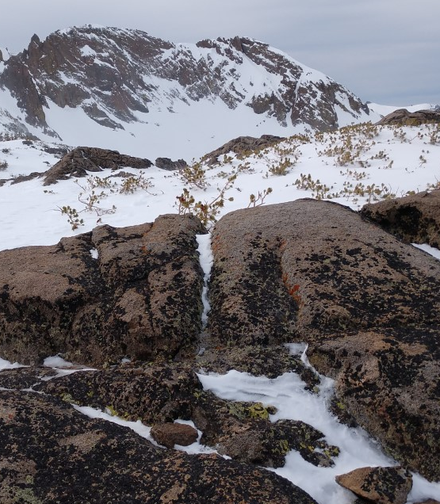

Slide 12
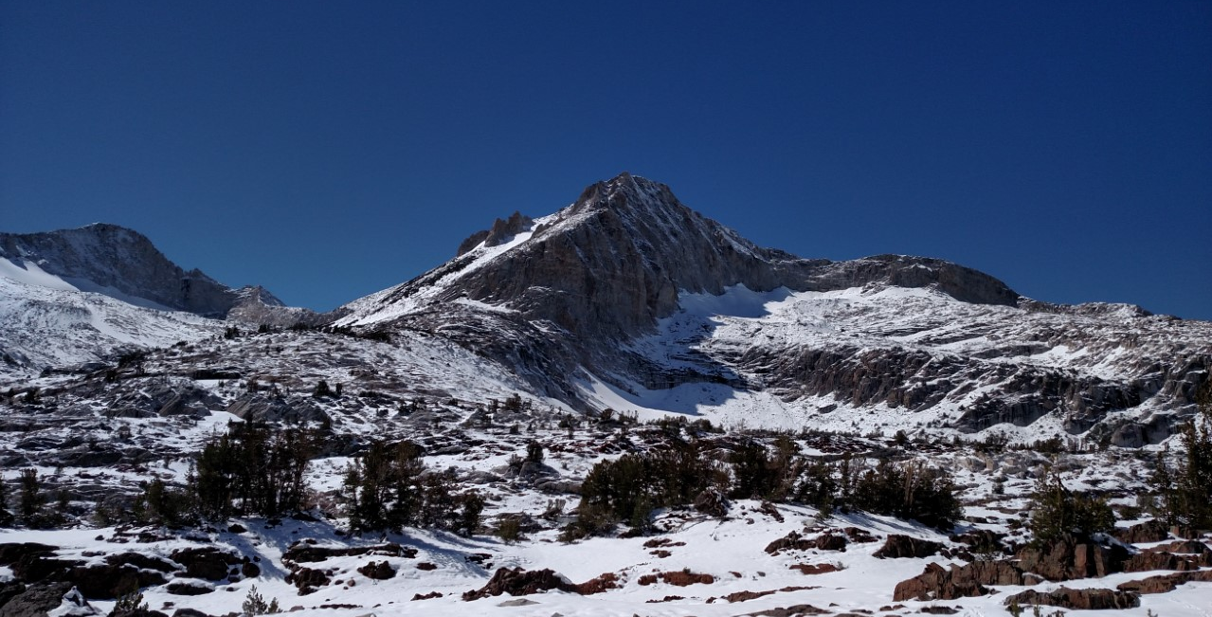
Large Image Slide
Fini

Slide 13
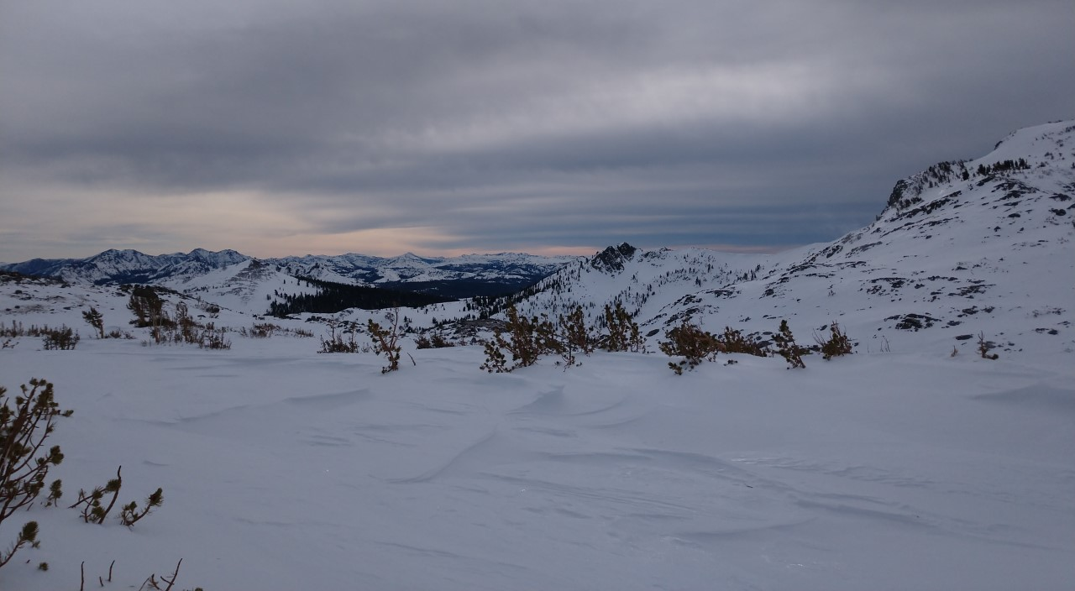




Thank You
Philip Kufeldt
+1 408 206 6689
philip@kufeldt.net

